Slide 1
Filtering and Ordering
SQL Day 2 Class

Slide 2
Learning Objectives
By the end of this lesson, you will be able to:
Filter SQL results with the WHERE clause.
Order results based on fields.

Slide 3
Filtering and Ordering SQL Results
What is filtering?
Filtering allows you to select a subset of rows from a table based on conditions
Common filtering keywords: WHERE, AND, OR
Example:
SELECT * FROM products
WHERE price < 10 AND stock > 0

Slide 4
Filtering and Ordering SQL Results
What is ordering?
Ordering sorts the result set by one or more columns in ascending or descending order
The ORDER BY keyword is used
Example:
SELECT * FROM products
ORDER BY price DESC

Slide 5
Filtering and Ordering SQL Results
Key Takeaways:
Filtering reduces results to rows fulfilling a condition
Ordering sorts results based on column values
WHERE, ORDER BY are important keywords for manipulating query output

Slide 6
SQL Clause Sequencing
Every SQL statement has a logical flow driving how it processes, filters, groups, orders data through sequential clauses:
SELECT - Declare desired result set columns
FROM - Source tables to join/access
WHERE - Filter rows on conditions
GROUP BY - Aggregate to grouped rows
HAVING - Filter aggregated groups
ORDER BY - Sort output rows

Slide 7
SQL Clause Sequencing
Importance of Clause Sequence
The ordered clauses in SQL work collaboratively to handle data flow and transformations:
Later clauses receive result set from prior clauses
GROUP BY aggregates the WHERE filtered rows
HAVING filters trim unnecessary data
ORDER BY sorts the rows filtered

Slide 8
WHERE Clause
The WHERE clause allows you to filter rows from a table based on conditions.
This is extremely useful for narrowing down queries to get just the subset of data you need.
Operators: Comparison operators like =, !=, <, >, <=, >= can be used to filter data:
= Equal to
!= Not equal
< Less than
> Greater than
<= Less than or equal
>= Greater than or equal

Slide 9
WHERE Clause
Uses
WHERE clauses work on string, numeric, and date/datetime data types.
Examples:
WHERE Price > 100
WHERE Name != 'Apple’
WHERE SaleDate < '1/1/2023’
Chain together operators with AND/OR to make more complex logical filters.
Example:
WHERE SalePrice > 500 AND ReleaseDate > ‘2020-01-01’

Slide 10
WHERE Clause
Check for NULL values using the IS NULL and IS NOT NULL operators.
For example:
WHERE PhoneNumber = NULL
Would actually return no rows, even if there are NULL phone numbers!
Instead, use:
WHERE PhoneNumber IS NULL
Similarly, to exclude NULLs:
WHERE PhoneNumber IS NOT NULL

Slide 11
Combining Filter Conditions
SQL provides operators for combining multiple filter criteria in the WHERE clause:
AND: Includes rows where ALL conditions are TRUE
OR: Includes rows where ANY conditions are TRUE
NOT: Reverses condition to exclude instead of include
Use Cases:
Filter by multi-criteria rules
Group criteria into inclusion buckets
Implement exclusion rules

Slide 12
Combining Filter Conditions
Narrow Criteria with AND
AND narrows query results by requiring rows to match ALL conditions.
Consider AND when you want:
Specific segments
(Region AND Revenue)
Filter dimensions
(Date AND Product)
Strict definitions
(Price > 100 AND Units < 50)
Example:
WHERE Region = 'West' AND Sales > 100000
Rows must meet both criteria.

Slide 13
Combining Filter Conditions
Using NOT to Exclude Filter Matches
NOT reverses the logic of filter conditions to EXCLUDE instead of INCLUDE matching rows.
Consider NOT when you want:
Exception reporting
(Exclude top regions)
Data quality checks
(NOT missing addresses)
Complementary slices
(NOT recent customers)
Example:
WHERE LastOrdered IS NOT NULL

Slide 14
Combining Filter Conditions
Using OR to Expand Filter Options
The OR operator widens the filter criteria, allowing rows to match if they satisfy ANY of the conditions.
Consider OR when you want:
Flexible searches (Brand A OR Brand B products)
Buckets of data (New OR Existing customers)
Criteria variations (Sales >= $1000 OR Volume > 500)
Example:
WHERE Region = 'West' OR Sales > 100000

Slide 15
Pattern Matching
LIKE Wildcards
The LIKE operator allows you to match text patterns in string data rather than exact literal values.
The LIKE operator uses two wildcards for flexible pattern matching in strings:
% Percent sign Matches zero or more characters A substitute for any set of characters
_ Underscore Matches a single character A placeholder for an individual unknown character

Slide 16
Pattern Matching
Examples:
WHERE Name LIKE 'Data%’
Values starting with "Data”
WHERE ProductCode LIKE '2%3'
Values starting with 2 and ending in 3
WHERE Phone LIKE '507-9__-____'
507 area code + 9XX + 4-digit number
WHERE Title NOT LIKE '%Analyst%’
You can also negate patterns with NOT LIKE

Slide 17
Ordering Results Sets
Ordering Result Sets
The order of rows returned in an SQL query result matters greatly for effective analysis.
While filters narrow what rows come back, ordering controls presentation sequence.
Key reasons precise ordering is crucial:
Surface most important records first
(Show best performing products first)
Detect patterns and outliers
(Consistency checking ordered transactions)

Slide 18
Ordering Results Sets
ASC Order - Low to High
The ASC keyword applied in ORDER BY sorts result set rows in ascending order, from lowest to highest value, for the specified column.
Key behaviors:
Numbers ascend lowest to highest value
(1, 5, 10, 100)
Dates ascend earliest to latest
('2020-01-01', '2022-05-05')
Text sorts alphabetically A-Z
('Apple', 'Banana', 'Orange')
Used by default if no order specified

Slide 19
Ordering Results Sets
DESC Order - High to Low
The DESC keyword applied in ORDER BY sorts result set rows in descending order, from highest to lowest value, for the specified column.
Key behaviors:
Numbers descend highest to lowest
(100, 10, 5, 1)
Dates descend latest to earliest
('2022-05-05', '2020-01-01')
Text sorts Z-A alphabetically
('Orange', 'Banana', 'Apple')

Slide 20
SQL Clause Sequencing
Key things to internalize:
Filter Rows Concisely with WHERE
Add precise conditions selecting only the most essential data. Every row evaluated puts load on the database.
Sort Results Clearly with ORDER BY
Sequence result sets suitably for usage based on logical rules over columns indicating importance, priority and structure.
Optimize Gracefully For Pace
The database engine parses SQL syntax and determines efficient execution plans.
Avoid overly complex logic when simpler approaches suffice.
.

Slide 21
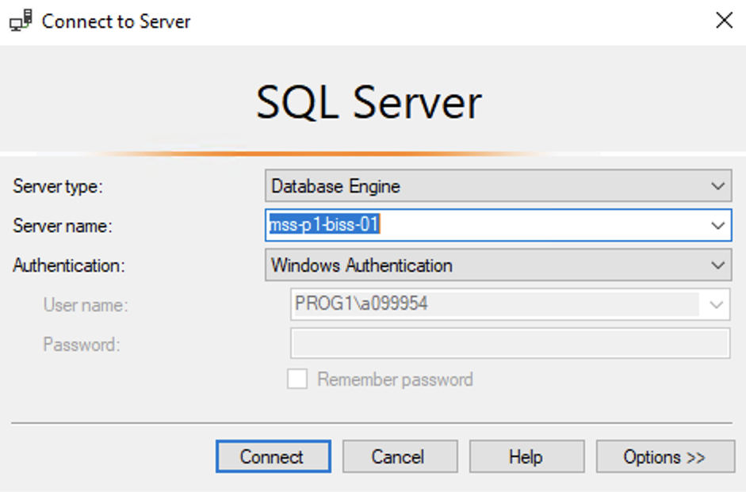
Hands On Examples
Using the AdventureWorks2012 Database
Please open up SSMS
Connect to BISS
Server = mss-p1-biss-01

Slide 22
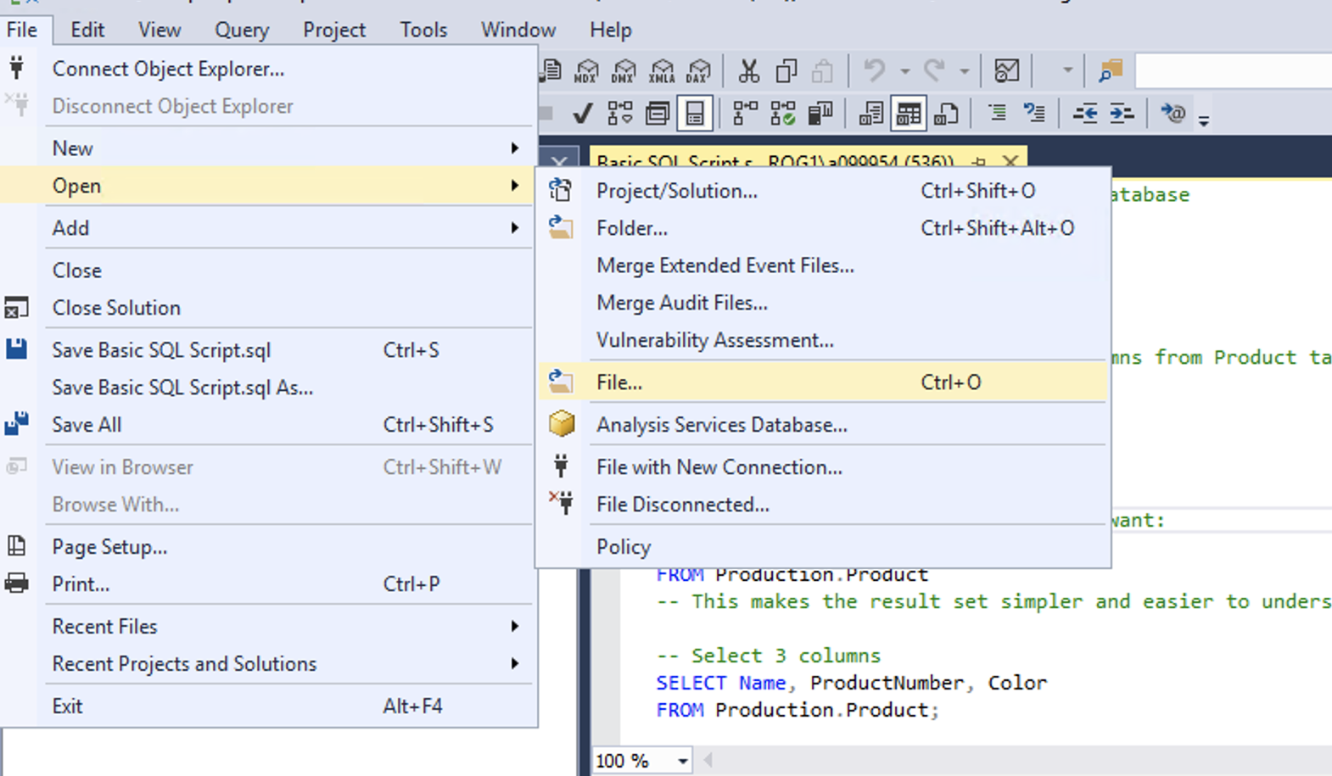
Hands On Examples
Click File -> Open -> File

Slide 23
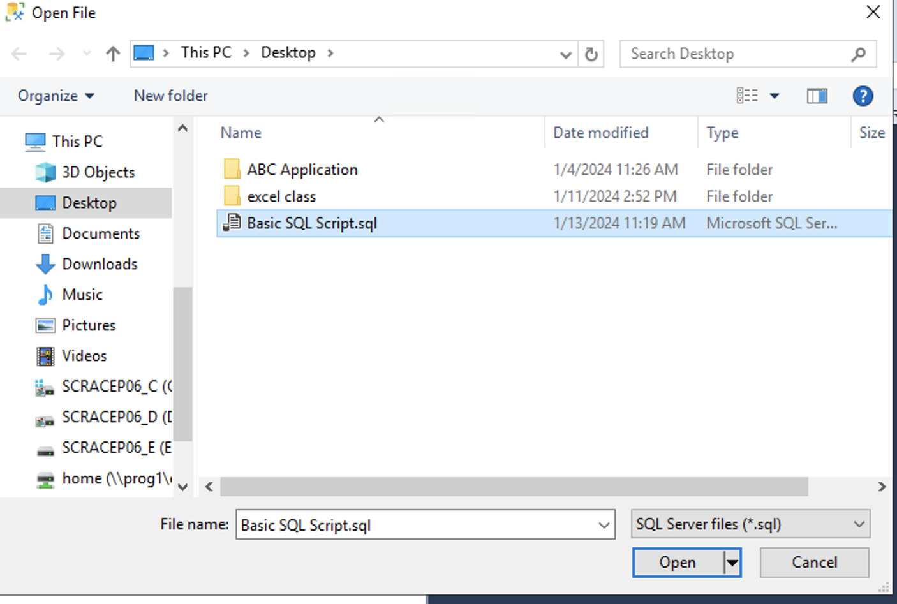
Hands On Examples
Open the SQL Day 2 Filtering and Ordering Script.sql file
Notes:
Walk through each function

Slide 24
Hands On Examples
Using the AdventureWorks2012 Database
Please open up SSMS
Connect to BISS
Server = mss-p1-biss-01

Slide 25
Hands On Examples
Click File -> Open -> File

Slide 26
Hands On Examples
Open the SQL Day 2 Filtering and Ordering Script.sql file
Notes:
Walk through each function

Slide 27
Exercise
Open the Day 2 Exercise.sql file
Answer the questions from each section
Notes:
Answers are stored in the Exercise Answers.sql file

